Slide 1
Recitation #2
17-356/17-766

Slide 2
TAs
Mehul Agarwal
email: mehula@andrew.cmu.edu
office hours: TBD
Rohit Shreenivas
email: rshreeni@andrew.cmu.edu
office hours: TBD

Slide 3
Full-stack Development
Different levels of the stack:
Backend
Frontend
Database
Deployment
Testing
and more

Slide 4
Full-stack Development
Different levels of the stack:
Backend
Frontend
Database
Deployment
Testing
and more
Today’s topic

Slide 5
BACKEND DEVELOPMENT USING NODE.JS

Slide 6
What is Node?
Back-end JavaScript runtime environment, runs on the V8 JavaScript Engine
Used for server-side scripting
Has an event-driven architecture capable of asynchronous(non-blocking) I/O.
Used to build fast, powerful and scalable web applications

Slide 7
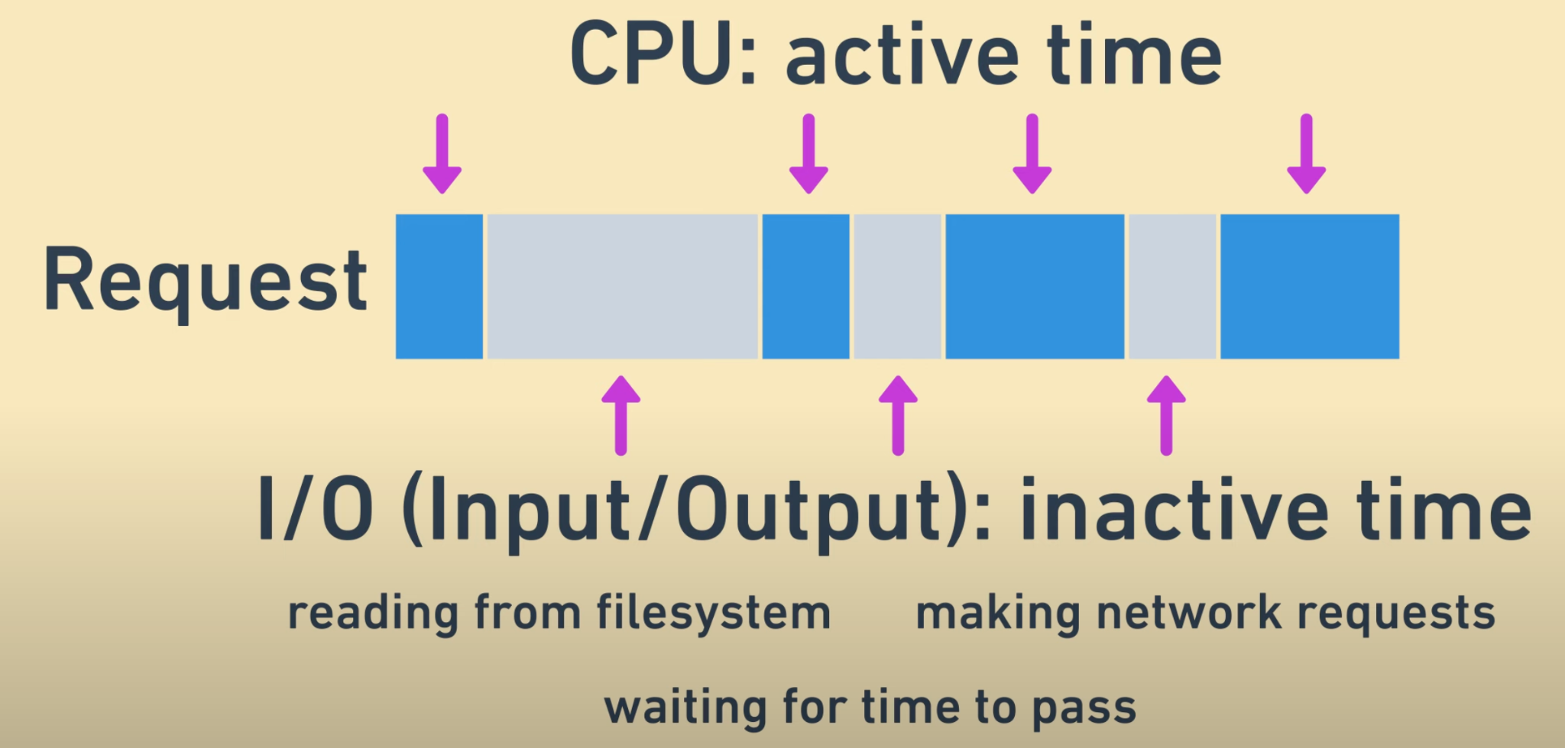
Asynchronous or Non-blocking I/O
Every request consists of:

Slide 8
Asynchronous or Non-blocking I/O
Non-blocking I/O allows a thread to suspend a request while it’s performing I/O to go work on a different request
Runs on a single-thread event loop, using non-blocking I/O calls, allowing it to support tens of thousands of concurrent connections without incurring the cost of thread context switching
Concurrency (in Node) refers to the Event Loop’s capacity to execute Javascript “callback” functions after completing other work

Slide 9
Node js async options
Callbacks: Functions passed to another functions
Promises (and promise chains): Structured callbacks
Generators: Functions which can be exited/paused and later re-entered
Async/Await: Combining generators and promises

Slide 10
Node Package Manager (npm)
Consists of:
npm client - command line tool
npm registry - an online database of public and paid-for private packages
The largest ecosystem of open-source libraries in the world

Slide 11
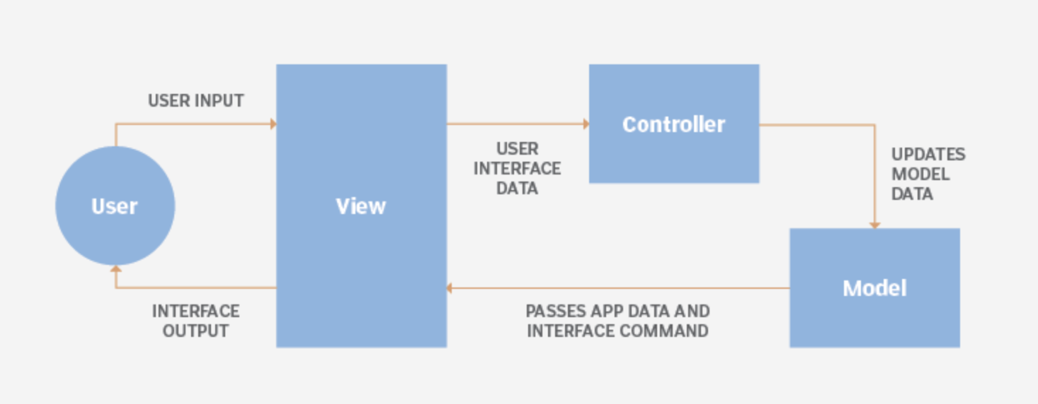
Model View Controller (MVC)

Slide 12
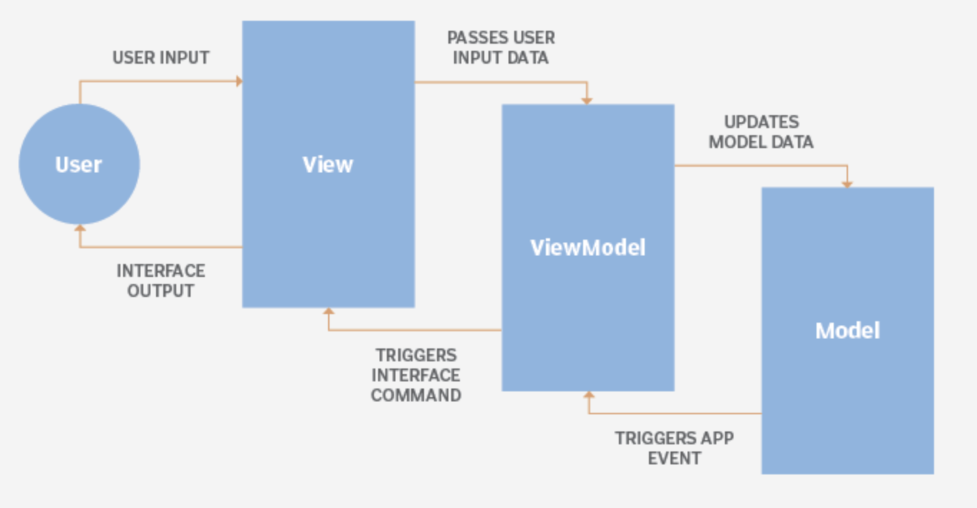
Model View Viewmodel (MVVM)

Slide 13
A SIMPLE TO-DO APP USING NODE.JS

Slide 14
STEPS:
mkdir your project folder (todo-app) and cd into it
npm init
npm install express --save
npm install body-parser --save
Write express code, as seen in the reference solution
node index.js (to start the server)
(optional) Play with the server, send it post requests
Notes:
https://nodejs.org/en/download/

Slide 15
